Slide 1
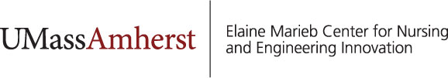
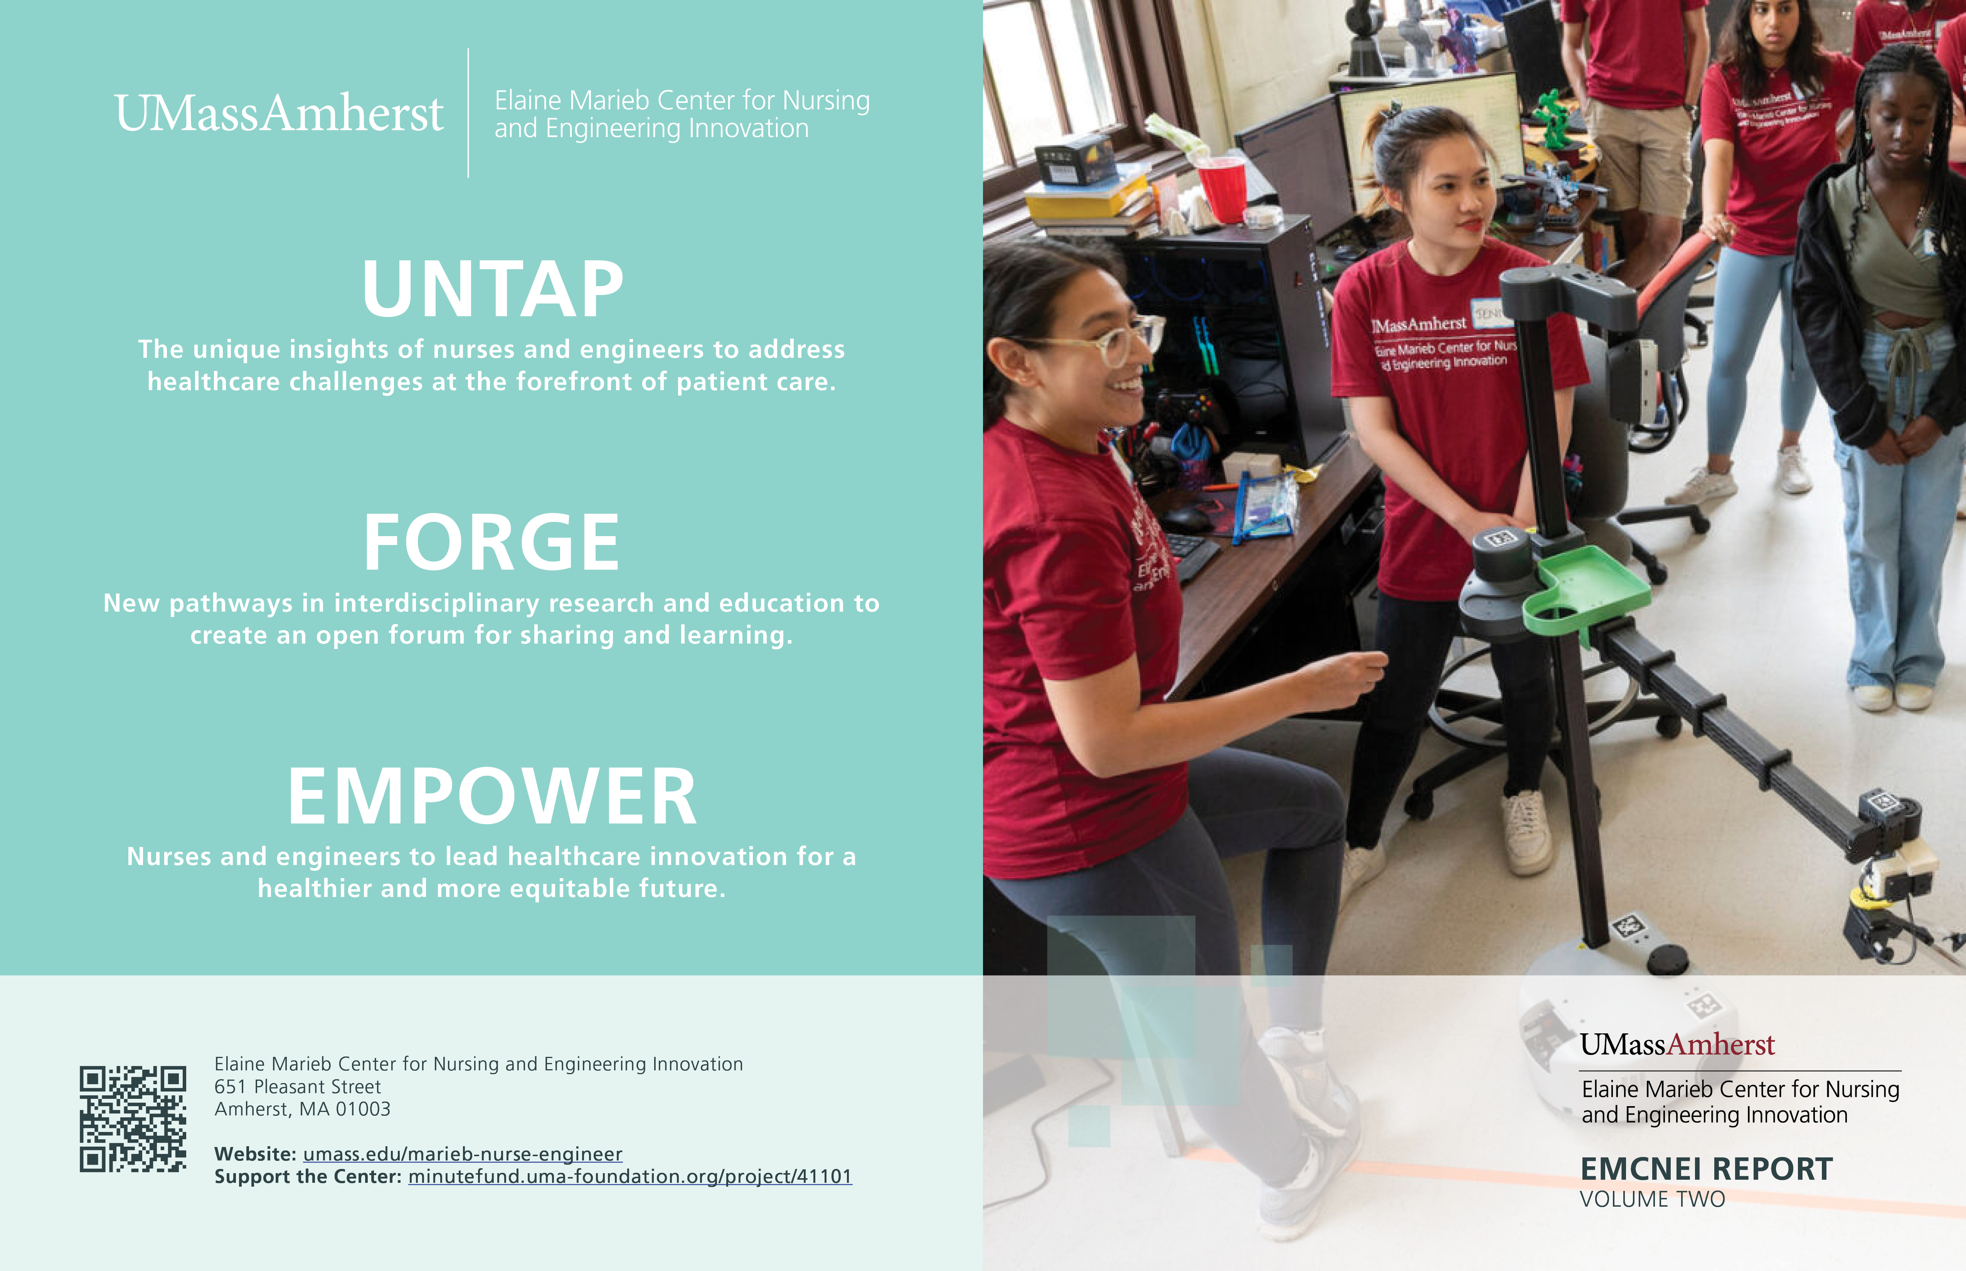
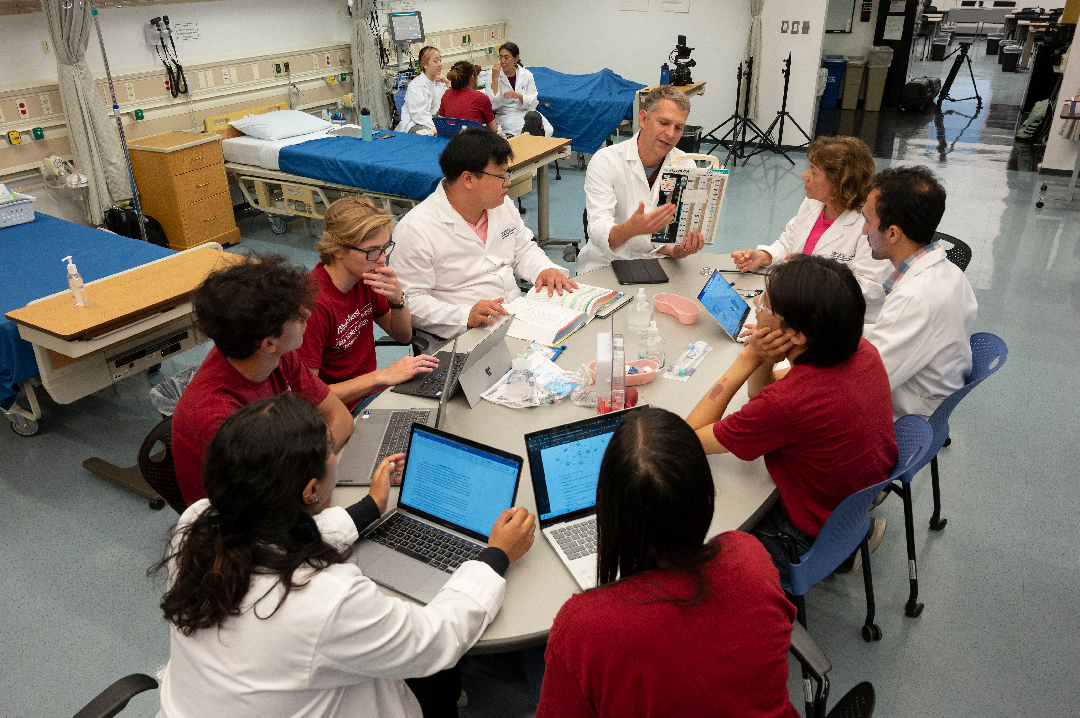
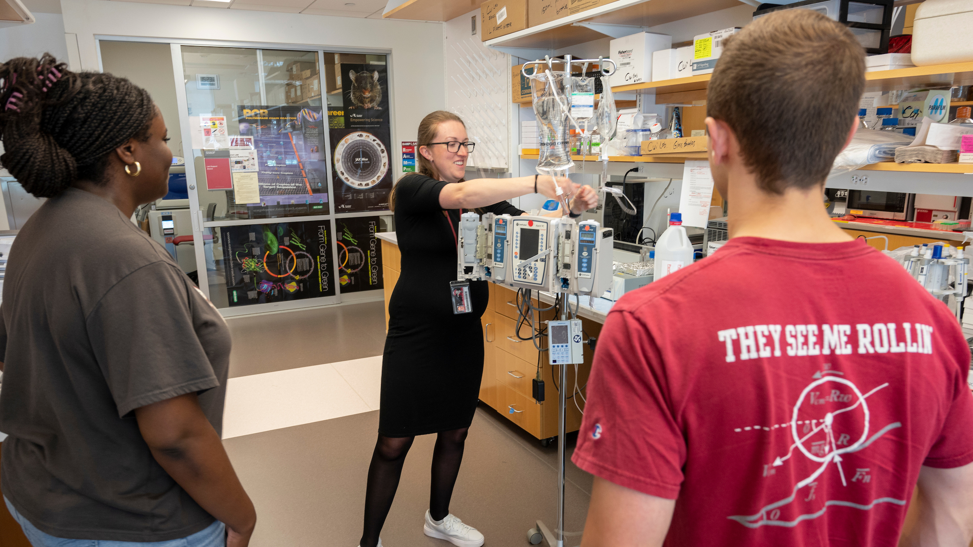
Developing the Next Generation of Interdisciplinary Healthcare Innovation Leaders
Nursing & Engineering Co-Directors, 23 UMass Interdisciplinary Affiliated Faculty with an internal pilot project grant program
25+ graduate and undergraduate researchers across colleges + high school summer interns, capstone engineering projects, honors student theses
First-ever ASEE E-Fellows Engineering Postdoc for a Nurse!
Launching a dual 5-year BME-Nursing UG degree
Freshman seminars and electives focused on inclusive and collaborative design
New online post-graduate certificate for clinicians on clinical healthcare technology assessment in collaboration with Edinburgh Napier University
Annual Symposium with industry partners (Baxter, Stryker, Nihon Kohden, GE Healthcare, etc.)
Two MA state innovation awards (2022 & 2023)
Clinical collaboration with Baystate Health and launching a clinical innovation unit
Nationally recognized program on improving the safety and usability of IV smart pumps
nurse-engineer@umass.edu
umass.edu/marieb-nurse-engineer
Notes:
Talking Points:
Established in 2021 by two generous donations through collaboration between Colleges of Engineering and Nursing, building on a legacy of inter-college cooperation.
Decade of Hluchyj fellowships prior supporting collab between colleges
NSF Supported Nurse-Engineer Capstone design program
NIH P20 on self-managed care co-led
Joint leadership with Co-Directors from Engineering and Nursing, with 23 Affiliated Faculty university-wide with 11 faculty pilot grants awarded to new partnerships.
Pursuing NSF NRT
New online post-graduate certificate for clinicians on clinical healthcare technology assessment in collaboration with Edinburgh Napier University. It is a new program at ENU that they are just launching in the fall. Karen working with the international program office at UMass to be able to offer it in collaborative with UMass so that our UMass students could take it and but get the degree and from UMass and UMass would get the tuition revenue. It is a way to help clinicians improve their technology knowledge. UMass faculty would teach some of the courses. Not sure if it will ultimately get approved, but just getting started.
Six graduate students and a Nursing postdoc with an ASEE Fellowship (Jeannine Blake) supported since inception.
20 undergraduates engaged so far through honors projects, summer internships
In Engineering, Nursing, Business, Computer Science, and Journalism
Launching a dual 5-year BME-Nursing with the first student enrolled
- Engage students through Freshman Seminars and technical electives focused on inclusive and collaborative design.
- Annual Symposium to connect students, faculty, clinicians, and industry partners (Baxter, Stryker, Nihon Kohden, GE Healthcare)

Slide 2
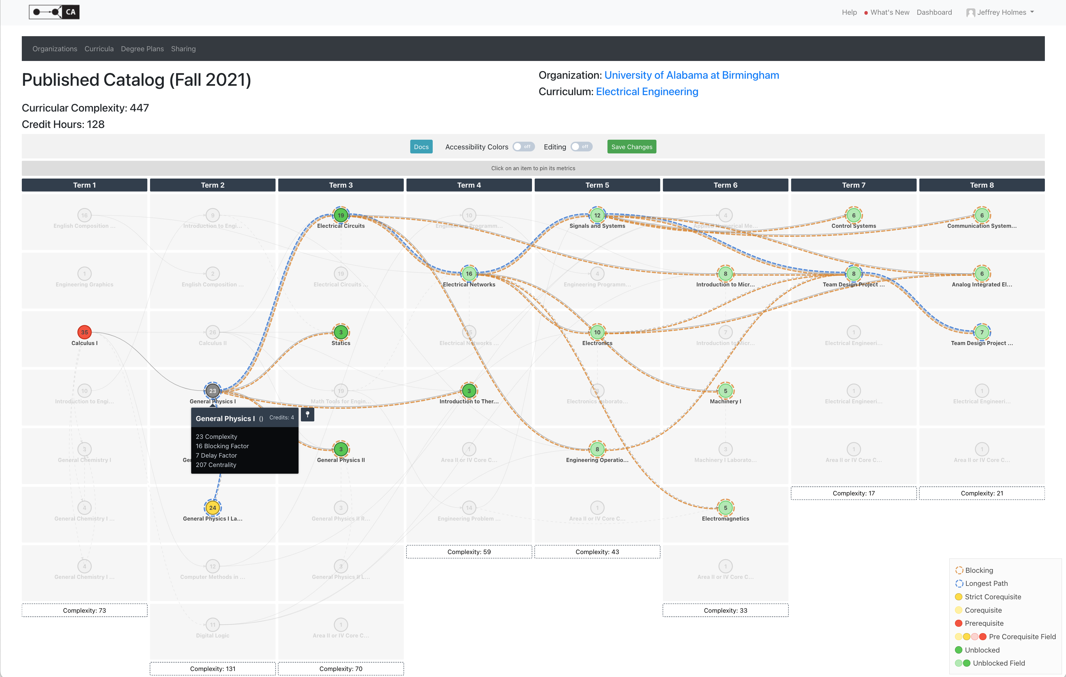
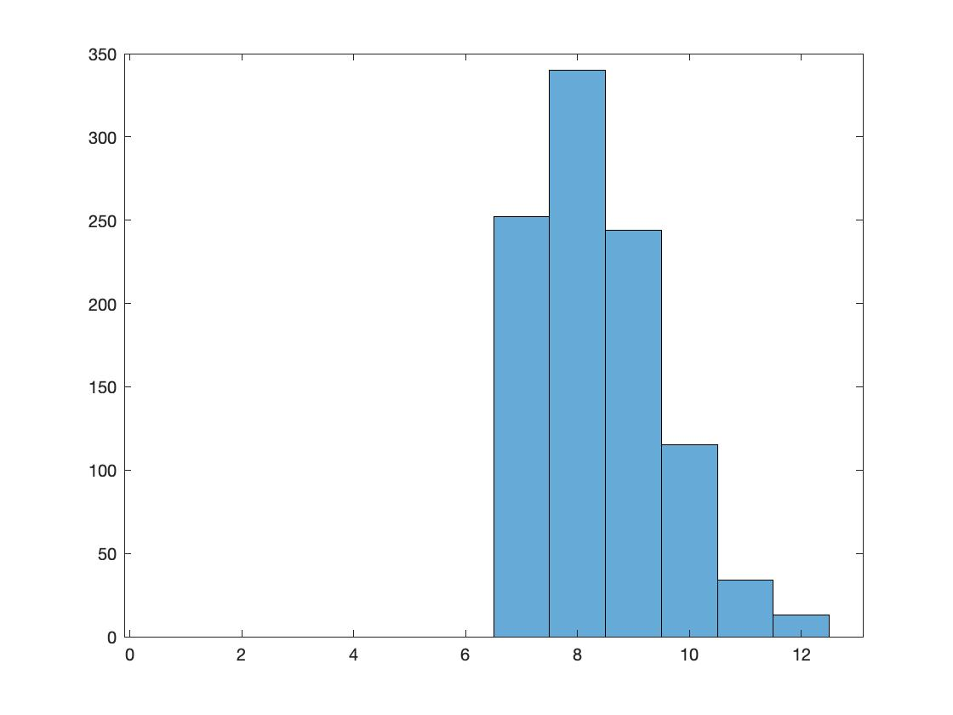
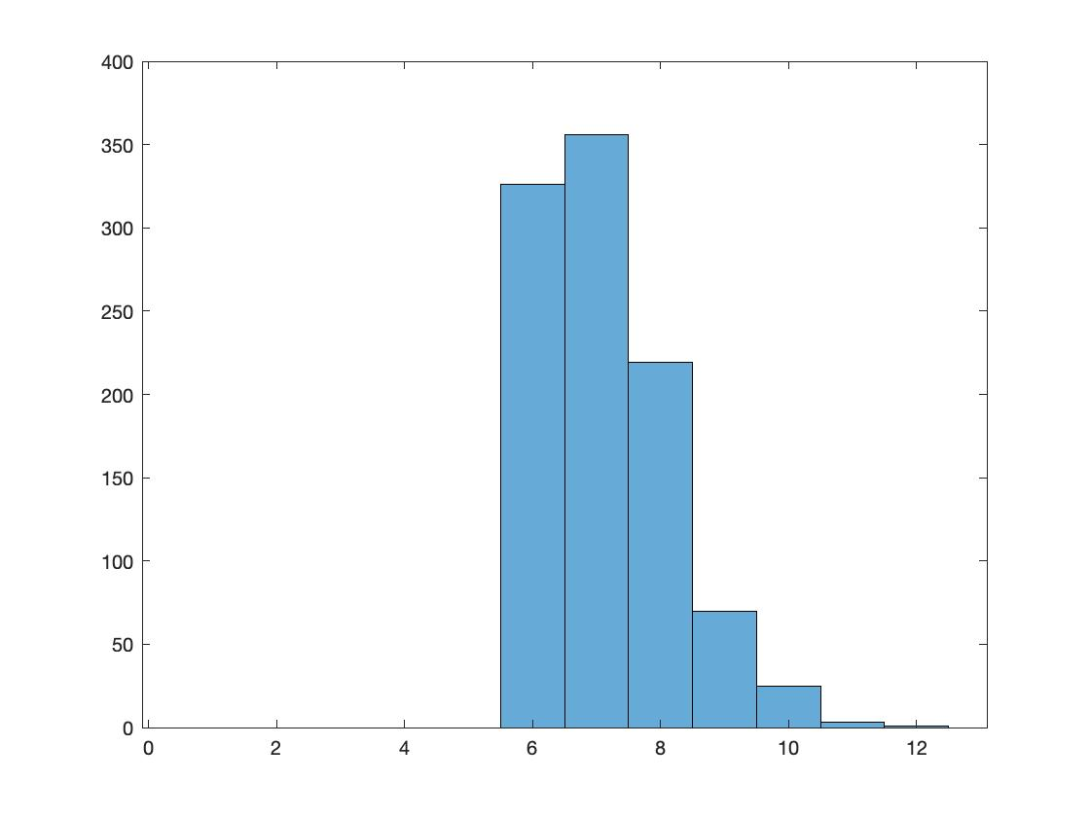
Cool Idea:
Simplifying Curricula
https://curricularanalytics.org
Complexity score
  ∝ predicted time to graduation
  (∝ 1 / ranking!)
Workshop
  pre-loaded curricula, facilitators familiar with software for each table/major
  identify single changes that would reduce complexity the most
  identify up to 3 changes you would consider (competing for greatest Δ)
  followed up with Monte Carlo simulations of impact on graduation
GL Heileman, CT Abdallah, A Slim, M Hickman. Curricular analytics: A framework for quantifying the impact of curricular reforms and pedagogical innovations. arXiv preprint arXiv:1811.09676
20% precalc
20% DFW
60% ≤ 8 sem
20% precalc
20% DFW
90% ≤ 8 sem

Slide 3

MICRON STUDENT SUCCESS CENTER
WHO ARE COEN STUDENTS?
Improve students’ equitable and navigable access to resources and experiential learning opportunities
Improve career success by helping all students discover career paths
Support and uphold equitable STEM education in COEN and surrounding Idaho community
Close retention and graduation gaps of key student populations in COEN in alignment with the university’s strategic plan
33% FIRST GEN
The Micron Student Success Center reestablished our COEN Ambassadors program hiring 13 Ambassadors from each department to support the center tied to outreach/recruitment, leadership, peer mentorship, and career discovery.
17% URM
Student-Centered Design Process
1
2
3
Build Relational Trust & Understanding
Conduct student-centered interviews with ambassadors to understand: (1) their decision to attend college, (2) the decision to apply to– and attend– Boise State, and (3) the decision to pursue their degree within COEN.
Recognize The System
“Zoom out” to consider the larger ‘system' of COEN, the resources provided by Boise State and the college, and build a deeper understanding of these resources from a variety of COEN stakeholder perspectives.
Co-Design For Success
As COEN works to iterate upon and design new resources to support COEN student success, here, we learn directly from students’ experiences via student-centered interviews and stakeholder ideation– creating open forums for dialogue and imagining to occur.
18% FEMALE

